Slide 1
Developing an algorithm to assess the likelihood of ground-level smoke: the RAQC Smoke IMpact Assessment System (SIMAS) project
Presenter:
Lyndsey DeMarco, Air Sciences
Contributors:
Tom Moore, RAQC
Kyra Reumann-Moore, RAQC
Katie Kolesar, Air Sciences
Matt Mavko, UNIVERSITY OF Arizona

Slide 2
Overview
Need for SIMAS, Ozone NAAQS Attainment planning
Project Goals
Methodology
Examples
Conclusions & Outcomes
Next Steps & Improvements

Slide 3
Smoke Impacts – Ozone Planning Needs
Denver Metro/North Front Range region is currently in Severe nonattainment for the 2008 ground-level ozone standard of 75 ppb and Serious nonattainment for the 2015 ozone standard of 70 ppb
The RAQC leads the development of state implementation plans (SIPs) in DN/NFR region in partnership with CDPHE
Modeling needed, baseline modeling years 2020-24
EPA Data Clarification Memo allows unrepresentative smokey days to be excluded from average in each year
4
Notes:
Wildfire smoke can either amplify ozone production by transporting more ozone precursors (oxides of nitrogen and volatile organic compounds to the area or can suppress ozone production by reducing the intensity of the ultraviolet radiation that is necessary for photochemical ozone production.

Slide 4
Smoke Impacts – Ozone Planning Needs
Wildfire smoke can amplify ozone production by transporting more ozone precursors (NOX, VOCs) to the area
Can also suppress ozone production by reducing the intensity of the ultraviolet radiation that is necessary for photochemical ozone production
Therefore, not representative of local impacts to ozone
Need to classify days with smoke impacts for these 5 years, so that ozone data on those days is not used in air quality planning
Lots of smoke in 2020 and 2021
4
Notes:
Wildfire smoke can either amplify ozone production by transporting more ozone precursors (oxides of nitrogen and volatile organic compounds to the area or can suppress ozone production by reducing the intensity of the ultraviolet radiation that is necessary for photochemical ozone production.

Slide 5
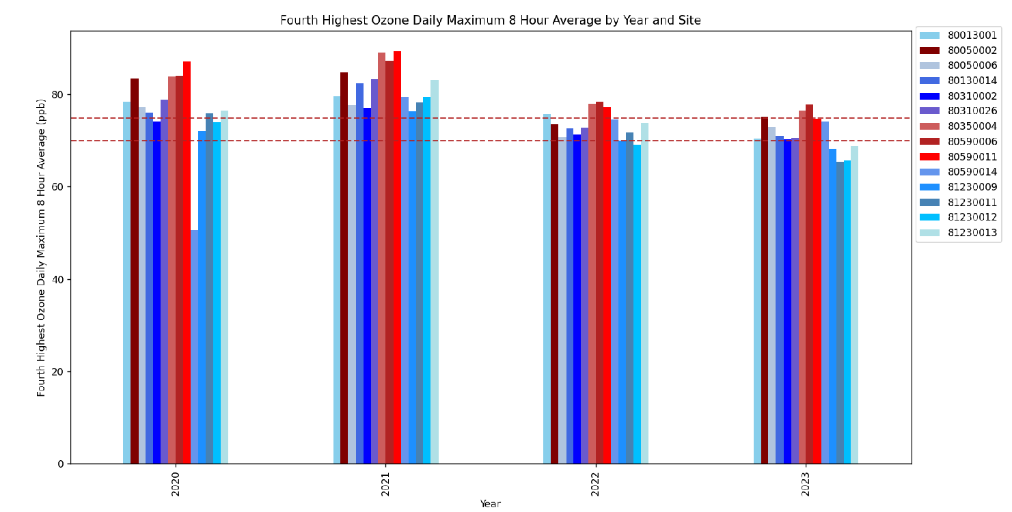
OZONE TRENDS IN THE FRONT RANGE
4th Highest Ozone Daily Max 8-Hr Average by Year and Site
Smokiest Recent Years
Welby
Highland
Aurora
Boulder Reservoir
CAMP
La Casa
Chatfield
Rocky Flats
NREL
Evergreen
Greeley
Weld
Weld
Platteville
2008 Std: 75 ppb
2015 Std: 70 ppb
Fourth Highest Ozone Daily Max 8 Hour Average (ppb)
2020
2021
2022
2023
Notes:
Not attributing smoke as the sole cause of these higher values

Slide 6
PROJECT GOALS
Purposes / outcomes from Smoke IMpacts Assessment System (SIMAS) project:
Develop method to classify all days in ozone planning season (May – September) as one of the following:
No smoke influence
Low probability of ground-level smoke influence
High probability of ground-level smoke influence
End Goal and Work Product
Evaluation period for this project focused on 2020 through 2024
Interactive display

Slide 7
Methodology – Smoke Impact Assessment System

Slide 8
Smoke Impact Assessment System Overview
NOAA Hazard Mapping System (HMS) Data
CDPHE PM2.5 Hourly Monitoring Data
EPA AirNow Daily AQI Maps
NOAA HRRR Atmospheric Model
SIMAS
Retrospective Smoke Classification
Map Display and Report
Notes:
Data outages

Slide 9
Smoke Impact Assessment System Overview
NOAA Hazard Mapping System (HMS) Data
CDPHE PM2.5 Hourly Monitoring Data
EPA AirNow Daily AQI Maps
NOAA HRRR Atmospheric Model
SIMAS
Retrospective Smoke Classification
Map Display and Report
Notes:
Data outages

Slide 10
Smoke Impact Assessment System – Data Sources
NOAA Hazard Mapping System (HMS) Data
CDPHE PM2.5 Hourly Monitoring Data
EPA AirNow Daily AQI Maps
NOAA HRRR Atmospheric Model
Requirements for all data sources
Publicly available
Large geographic range
Data that are updated at least daily
Easily accessible in automated way
Timeframe availability
Notes:
Will first go through the key aspects of each data input, then show the decision-making, then walk through an example.

Slide 11
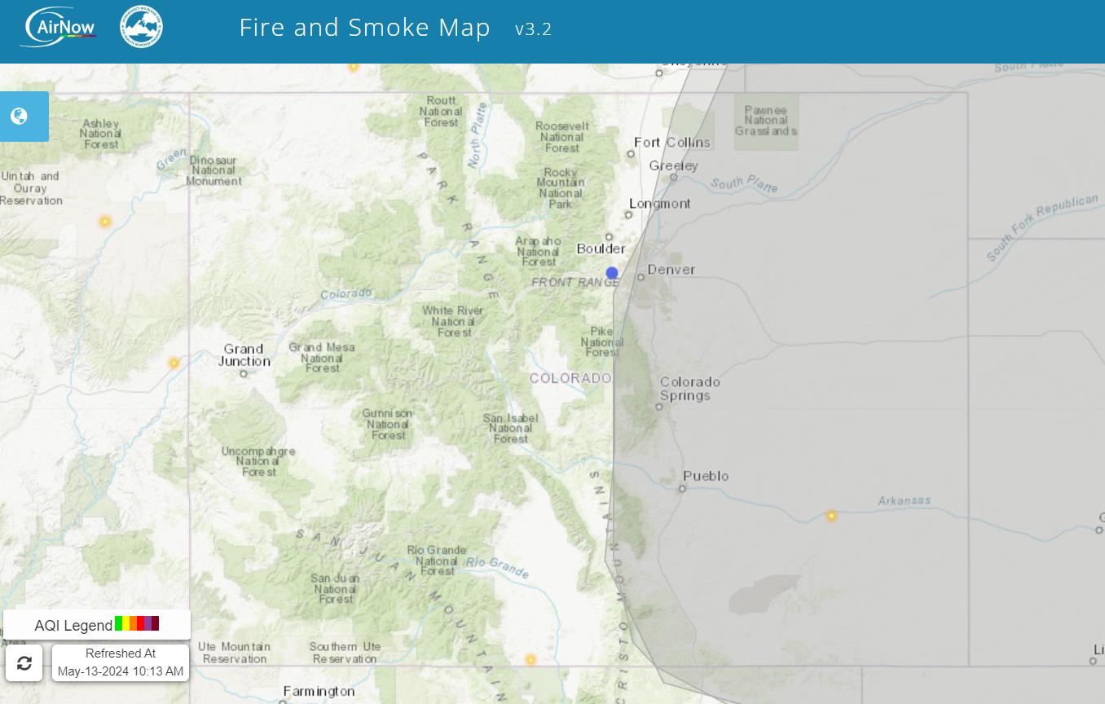
Hazard Mapping System (HMS) Smoke model
Key Points:
Only during daylight hours
Several per day but not hourly
Smoke level is assigned based on the highest level of smoke plume that intersected the station for the day – assessed for each station
Notes:
Mention that this is a modeled value based on the satellite detection of fires and then how that is translated to smoke – high level
Talk about scale of model, full column, not just at ground level. Continental pattern when going across the US, drops down a long the Rockies (backs in from the North)

Slide 12
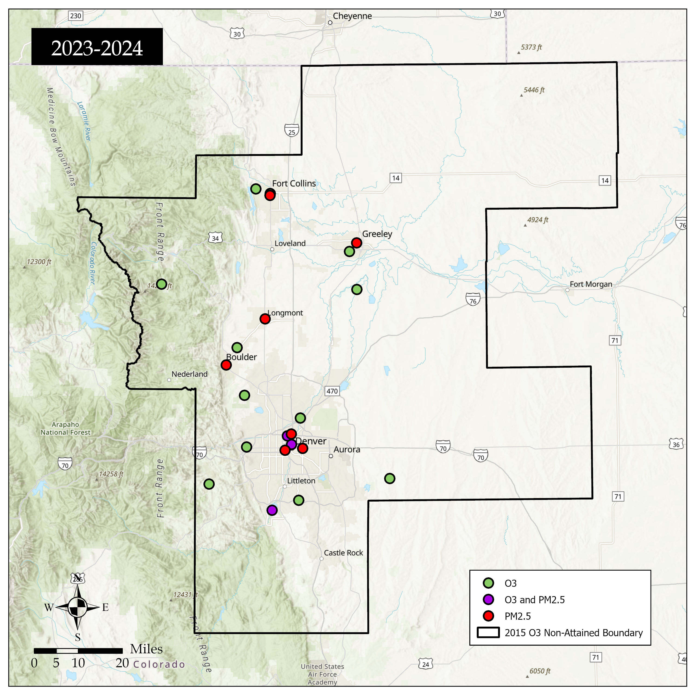
Monitoring Data
CDPHE PM2.5 Monitoring Data
Ground-level
Hourly data
Only available at some sites
EPA AirNow Data
EPA AirNow Daily AQI maps are used to estimate PM2.5 concentration at sites without this measurement
2015 O3 Non-Attainment Area
Notes:
Add in a map of the airnow contours

Slide 13
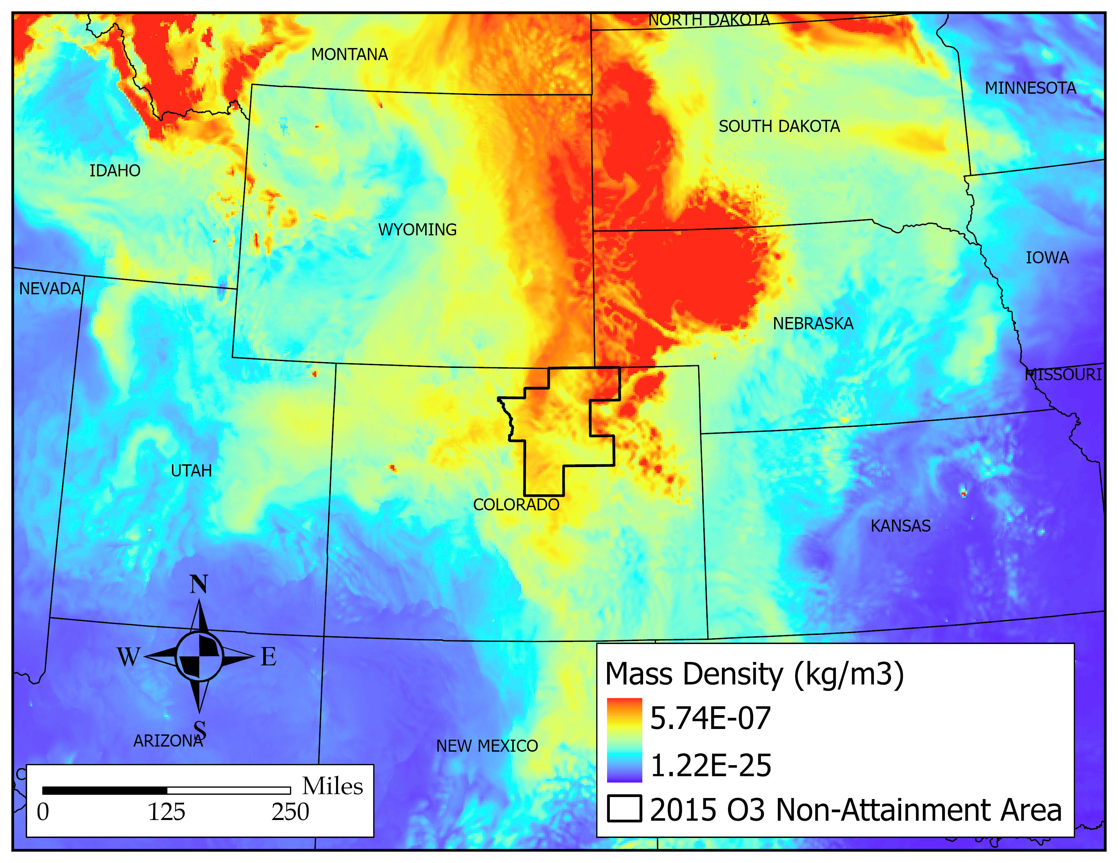
High Resolution Rapid Refresh (HRRR) Smoke model
Key Points:
Gridded 3D photochemical model like CAMx
Hourly model output of the mass density of PM2.5 at 8 meters above ground level from wildfire smoke
24 hours captured per day
Available from 2021 through present
Incorporated into the SIMAS as a ratio of the maximum hourly HRRR concentration to the maximum hourly PM2.5 concentration
Notes:
Smoke in front of Mass Density

Slide 14
Smoke Impact Assessment System Overview
NOAA Hazard Mapping System (HMS) Data
CDPHE PM2.5 Hourly Monitoring Data
EPA AirNow Daily AQI Maps
NOAA HRRR Atmospheric Model
SIMAS
Retrospective Smoke Classification
Map Display and Report
Notes:
Data outages

Slide 15
Smoke Impact Assessment System
Many multi-part if-statements that lead to different outcomes
Probability of Smoke at Ground Level
NOAA HMS Data | PM2.5 maximum hourly average |  | Ratio HRRR to PM2.5 daily maxima | SIMAS Evaluated Smoke Probability
None | Any |  | ≤ 0.11 | None
None | Any | AND | > 0.11 | Low Probability
Light | < 12 µg/m3 | AND | < 0.11 | None
Light | ≥ 12 ug/m3 & < 22.4 µg/m3 | OR | < 0.11 | Low Probability
Light | ≥ 22.4 µg/m3 | AND | ≥ 0.11 | High Probability
Medium | < 22.4 µg/m3 | OR | < 0.11 | Low Probability
Medium | ≥ 22.4 µg/m3 | AND | ≥ 0.11 | High Probability
Heavy | < 12 ug/m3 | AND | < 0.11 | Low Probability
Heavy | ≥ 12 ug/m3 | OR | ≥ 0.11 | High Probability
Notes:
This is not the PM2.5 daily standard
Cut points determined based on interquartile ranges of specific scenarios.

Slide 16
Smoke Impact Assessment System Overview
NOAA Hazard Mapping System (HMS) Data
CDPHE PM2.5 Hourly Monitoring Data
EPA AirNow Daily AQI Maps
NOAA HRRR Atmospheric Model
SIMAS
Retrospective Smoke Classification
Map Display and Report
Notes:
Data outages

Slide 17
Example: July 23, 2024
NOAA HMS Smoke Data

Slide 18
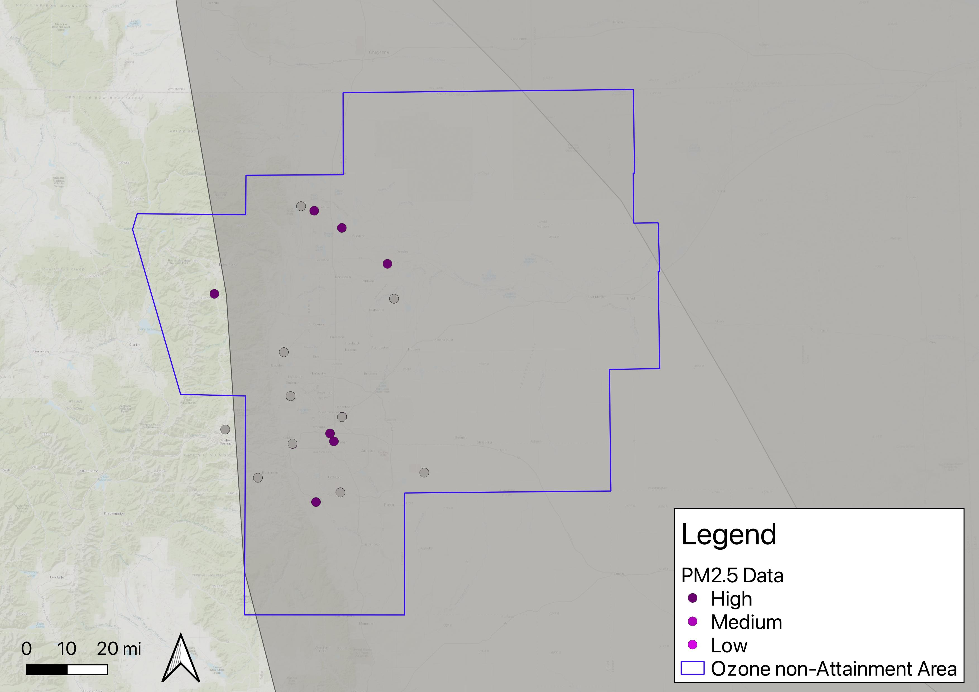
Example: July 23, 2024

Slide 19
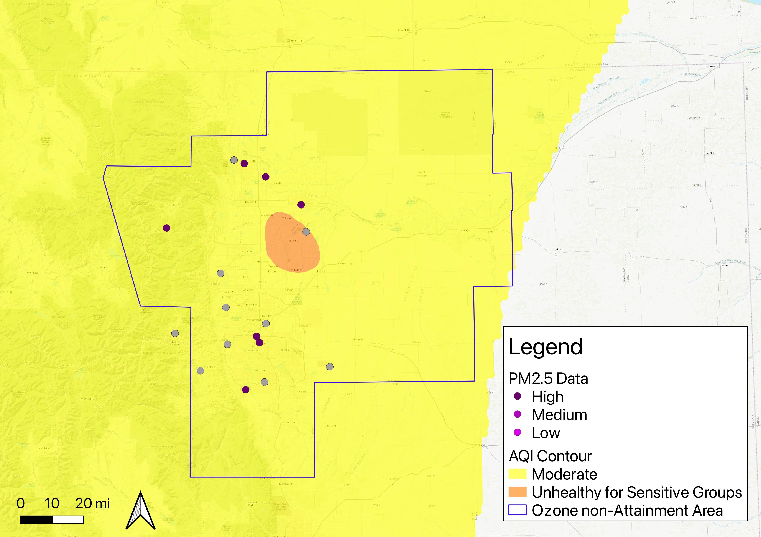
Example: July 23, 2024

Slide 20
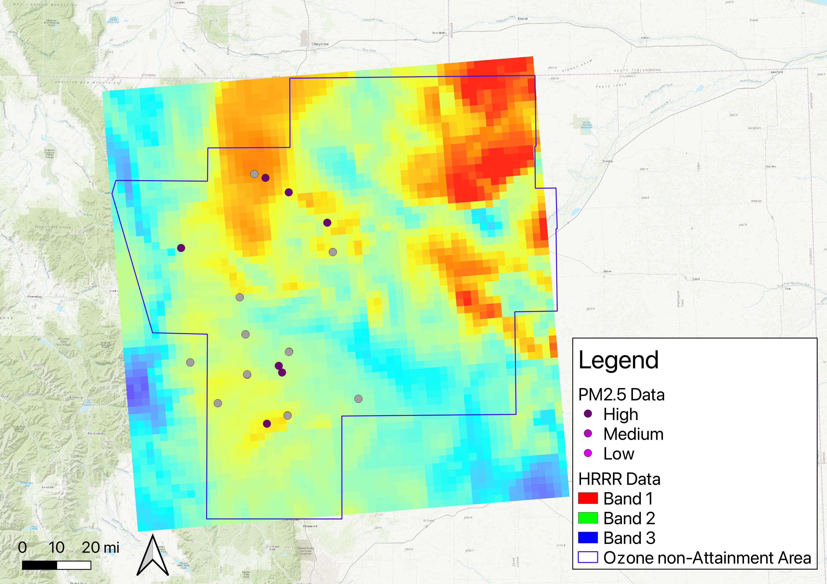
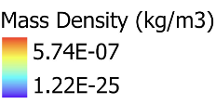
Example: July 23, 2024
NOAA HMS Smoke Data

Slide 21
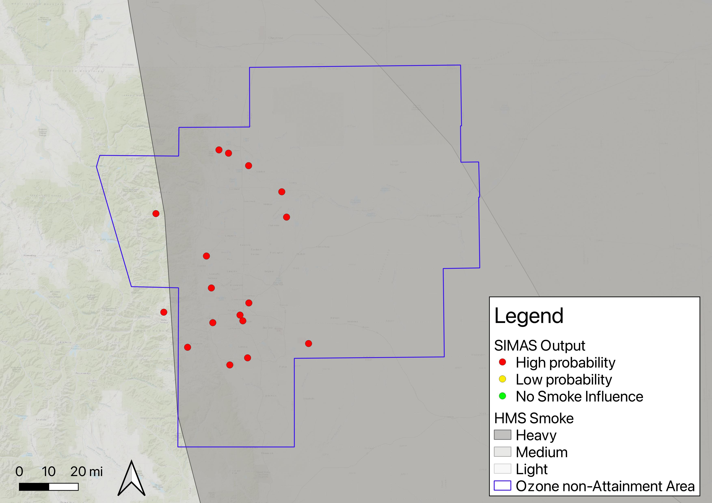
Example: July 23, 2024
NOAA HMS Smoke Data

Slide 22
Example: July 26, 2024
NOAA HMS Smoke Data
Notes:
Light smoke everywhere in the entire area – cannot see the boundary
Based on the ground level PM2.5 concentrations and modeled HRRR smoke – low probability

Slide 23
Example: August 1, 2024
NOAA HMS Smoke Data
Notes:
Localized event – Alexander Mountain Fire (started 7/29/2024)

Slide 24
Smoke Impact Assessment System Overview
NOAA Hazard Mapping System (HMS) Data
CDPHE PM2.5 Hourly Monitoring Data
EPA AirNow Daily AQI Maps
NOAA HRRR Atmospheric Model
SIMAS
Retrospective Smoke Classification
Map Display and Report
Notes:
Data outages

Slide 25
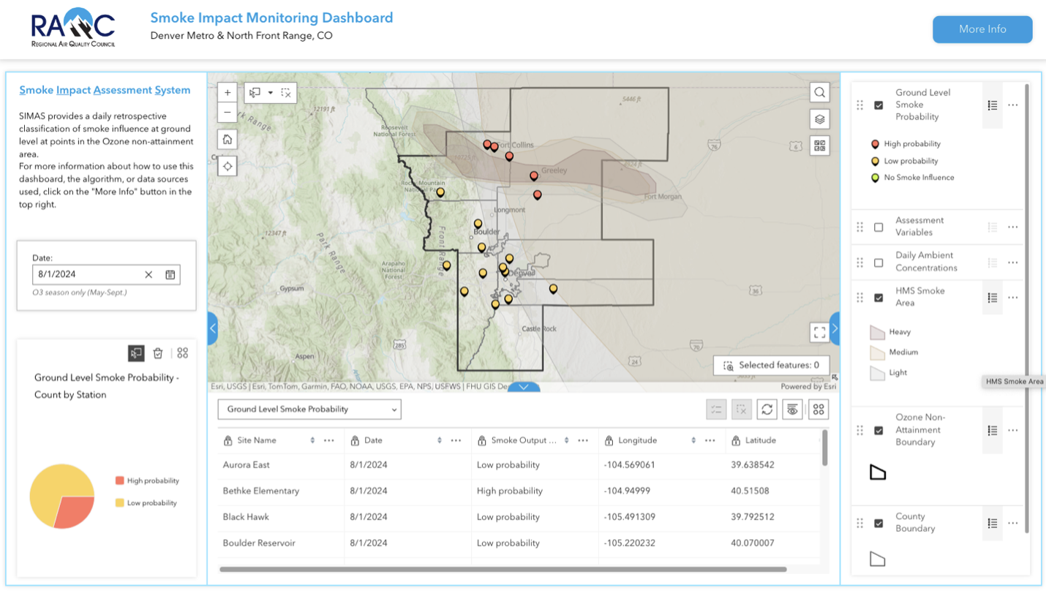
Smoke Impact Assessment System – Final Product
Notes:
Interactive ArcMap

Slide 26
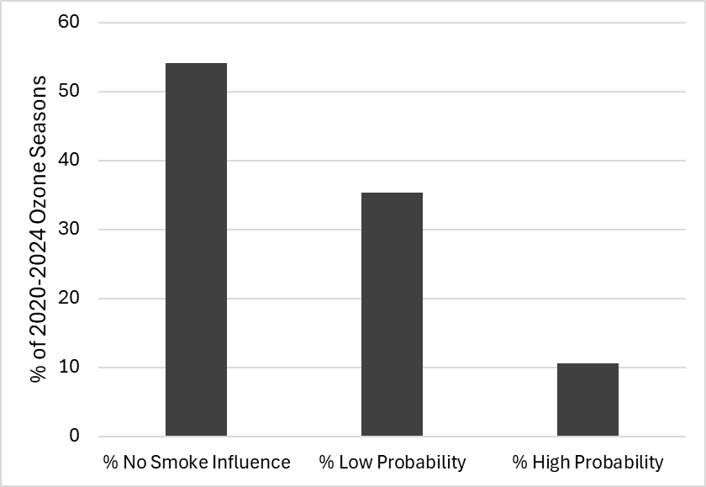
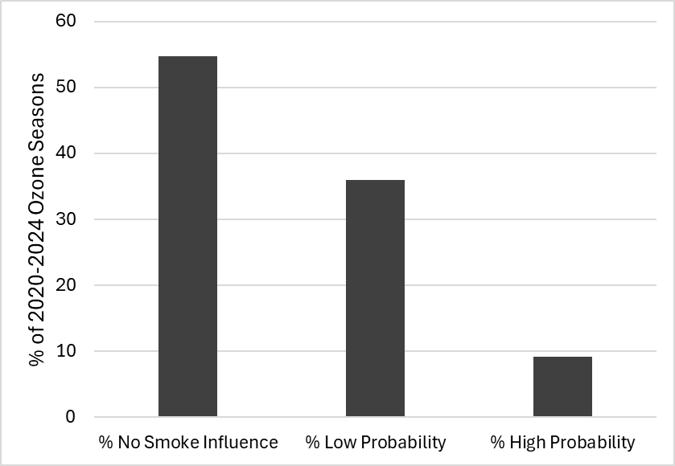
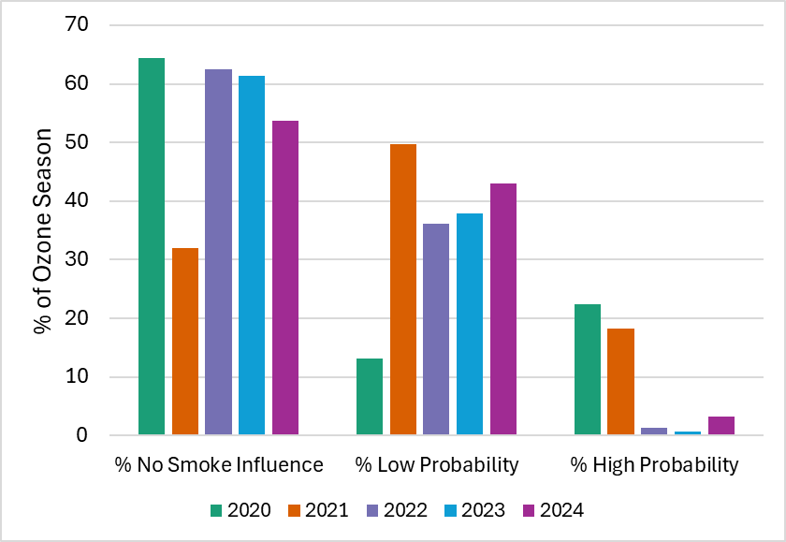
Smoke Impact Assessment System – Final Product
Fort Collins - West
Golden - NREL
Notes:
Note that 2020 did not have HRRR model data available, so it is harder to determine the difference between no smoke influence and low probability.
Example of making a smoke prediction for high ozone sites where we don’t have any measurement data at the site that reflects the amount of smoke – we can use the inputs to SIMAS to fill in the gaps where we don’t have PM2.5 data.

Slide 27
Conclusions & Outcomes
Successfully developed an algorithm that seems to reasonably classify smokey days
Based on case study from this summer
Comparisons to literature
Ran algorithm for 2020 – 2024 ozone season (May – September)
Developed an interactive web map dashboard for public & agency officials to see ground level smoke impact
This model could be applied to other regions that are doing SIP planning
All you need is local monitoring data

Slide 28
Next Steps & Improvements
Next Steps
Comparing to CDPHE’s identified smokey days to check alignment with SIMAS classifications
Automate algorithm for 2025 and beyond
Possible Improvements:
Station based thresholds versus region-wide
Utilize low-cost sensor networks, such as PurpleAir, to get more spatial coverage of PM_{2.5} data
Additional ranges of HRRR-Smoke values could be determined to add more complexity to the model

Slide 29
Questions
Thank you for Listening!
Notes:
Ask about if anyone wants to do follow up or regular check ins with the project

Slide 30
Determination of Cut-Points
Used 2020 to 2024 data to calculate percentiles for the following
Cutoff point for very high PM2.5 is the 25th percentile daily maximum PM2.5 concentration for days where the HMS smoke layer is heavy at the location of PM2.5 monitors.
Cutoff point for high PM2.5 is the 75th percentile daily maximum PM2.5 concentration for days where there is no HMS smoke layer at the location of PM2.5 monitors.
Cutoff point for the ratio of daily maximum NOAA HRRR model predicted concentration& to daily maximum PM2.5 concentration is the 75th percentile for days where there is no HMS smoke layer at the location of PM2.5 monitors.
Using hourly averages, not daily.
&Surface - Mass Density, at 8 meters height

