Slide 1
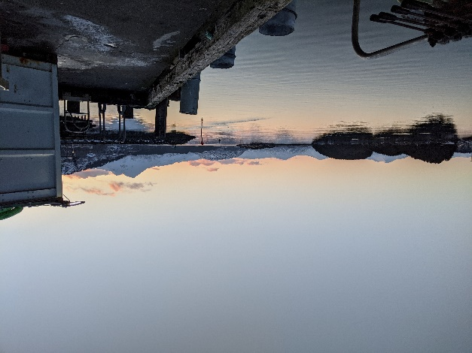
Out of sight, not out of compliance Advice for folks new to remote support Casey Fee, Air Sciences Inc. November 2024

Slide 2
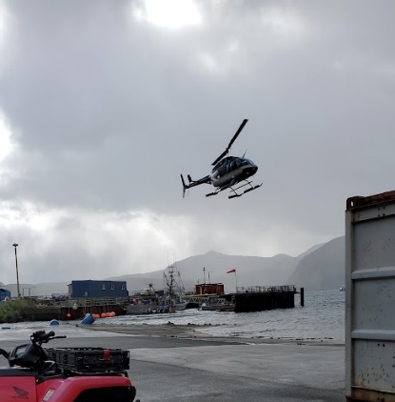
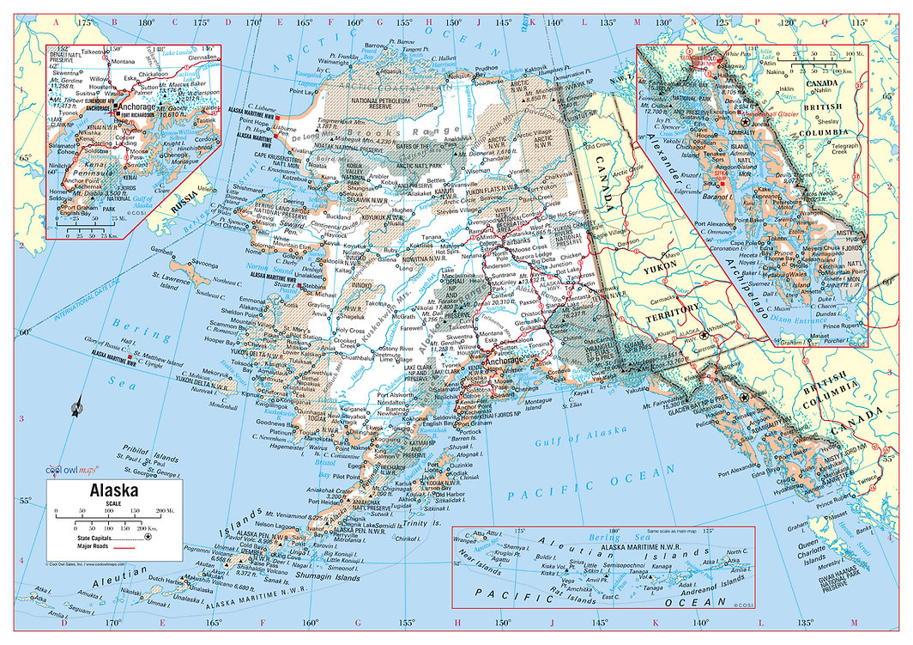
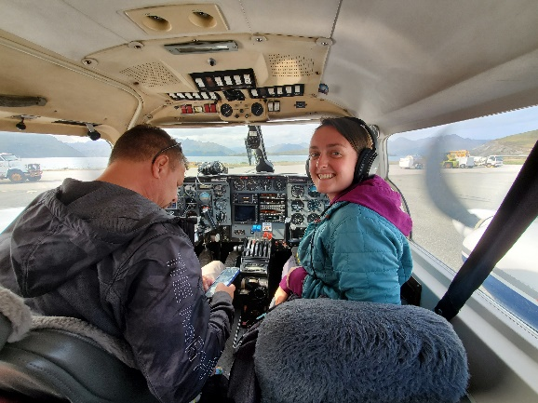
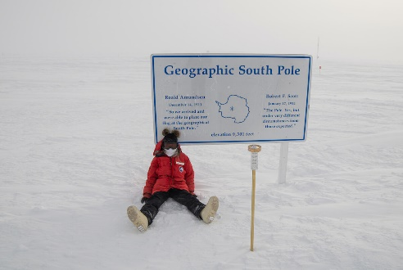
Who am I?
~10 years in compliance industry
Wastewater, Haz. Mat, stormwater, Oil, Air
Oil & Gas, Mining, Fisheries, BLM, Forest service, plastics, natural gas…
Been places!
Air Sciences – Air
Kaktovik
Sand Point
Akutan
Kodiak Island

Slide 3
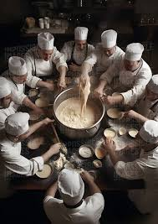
Summary
Know the players
Creating good documents
Equipment/Waste Accumulation
Planning
Come to peace with factors out of your control
Notes:
Assumes - At least one person is onsite at least seasonally

Slide 4
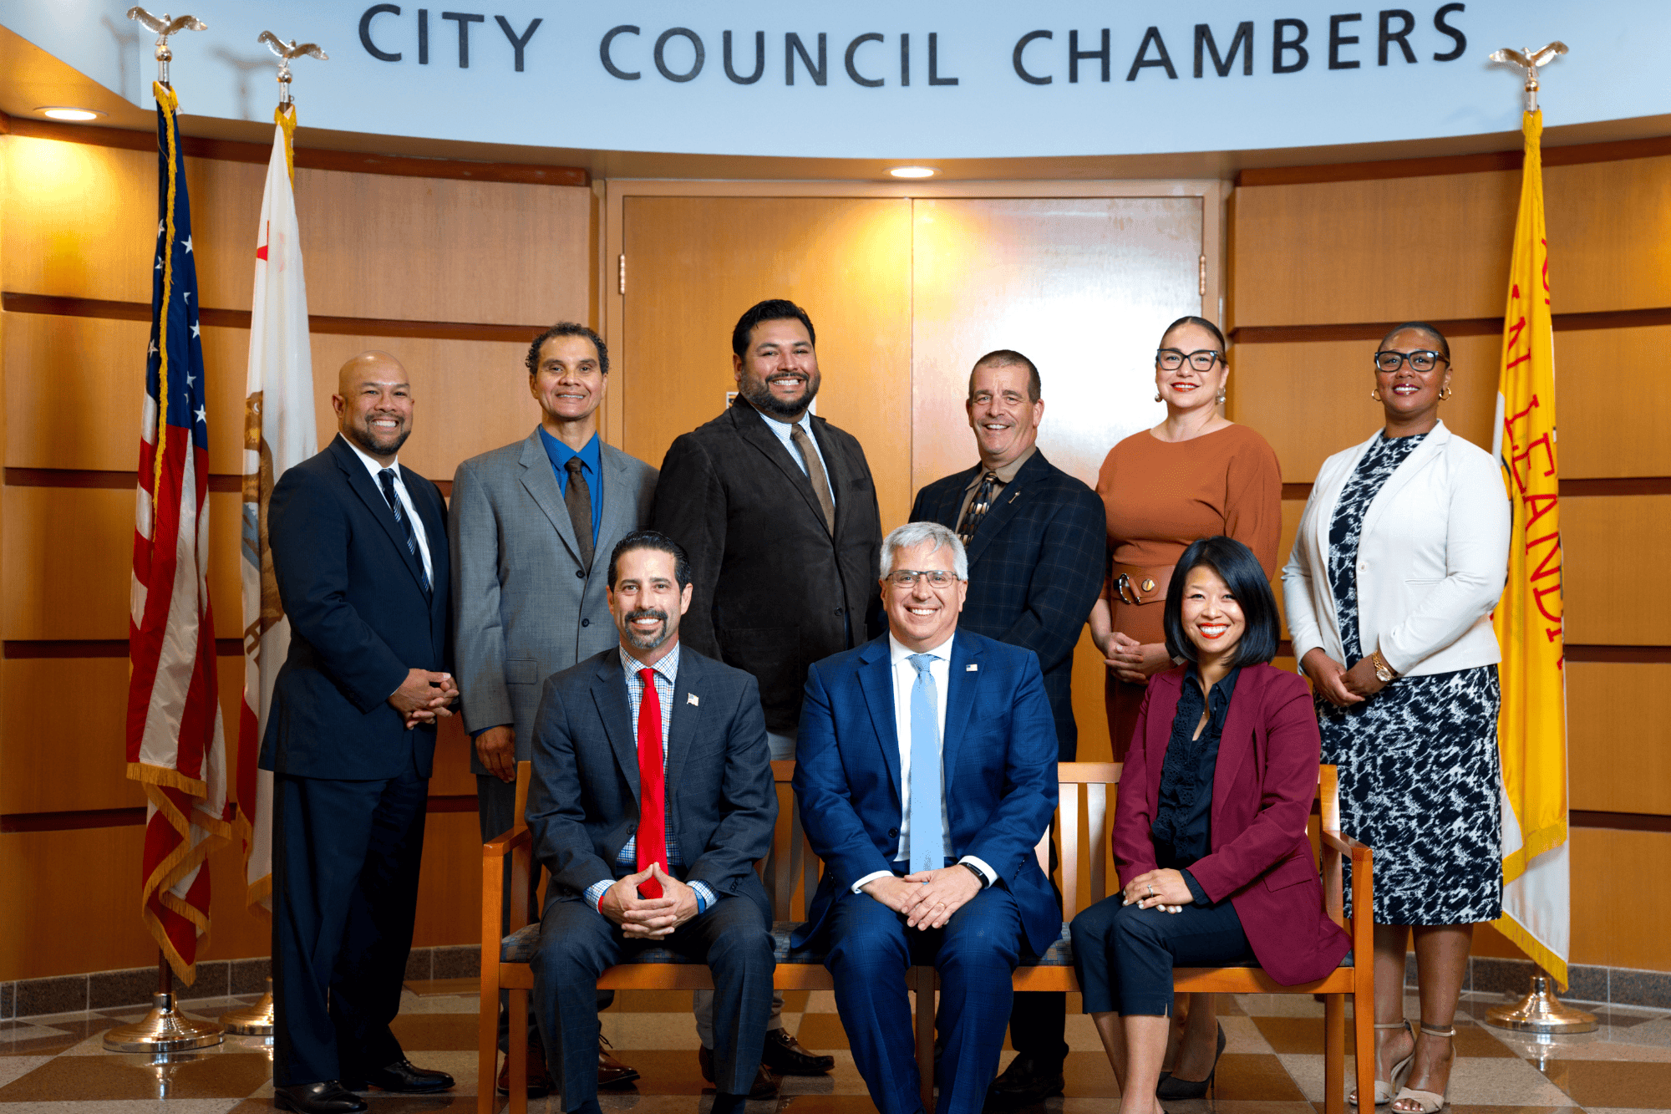
Know the players
Remote = Pristine Wilderness?
Remember: You all have the same goal
Notes:
Work closely with local communities (nothing else around)
Federal, EPA
Military
State
City/County/Boroughs
Local Fire Marshalls & Police
Nonprofits
International Bird Rescue, International Wildlife Research, Sealife Centers
Bird, wildlife sanctuary's
Water = way more folks involved . Coast Guard
Fish and Game
Natural Resources
Cultural Resources
Forest Service
Environmental Department
Spill Response

Slide 5
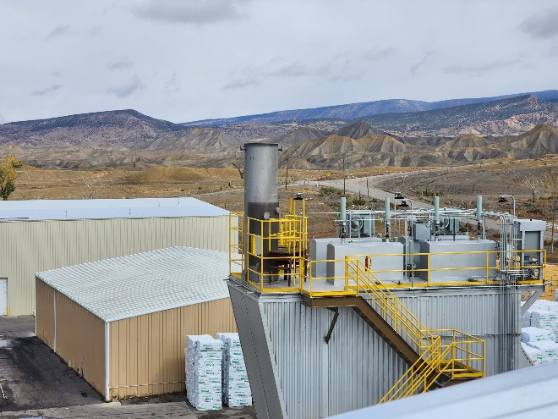
Onsite
Full Time
Seasonal?
Make their job as easy as possible to do it.
Onsite Facility
Night shift, the forgotten shift
Relationships Support your Team
Notes:
Full Time
Seasonal?
Make their job as easy as possible to do it.
Onsite Facility
Night shift, the forgotten shift
Making resources that transferable
Robust

Slide 6
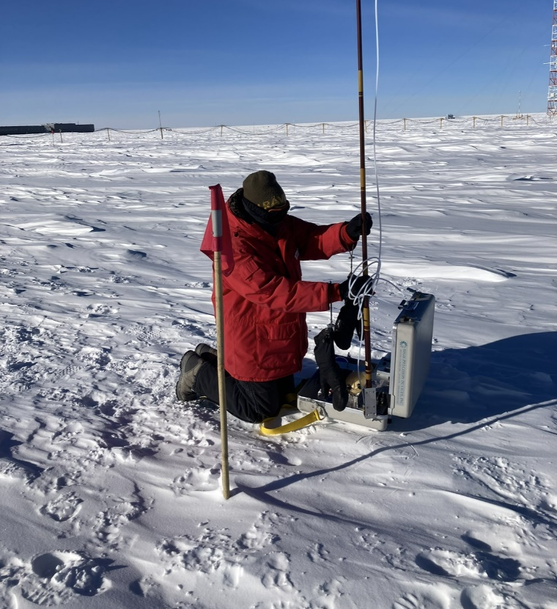
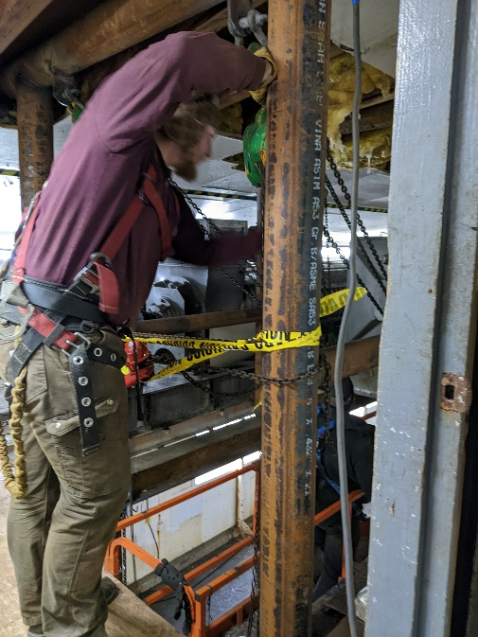
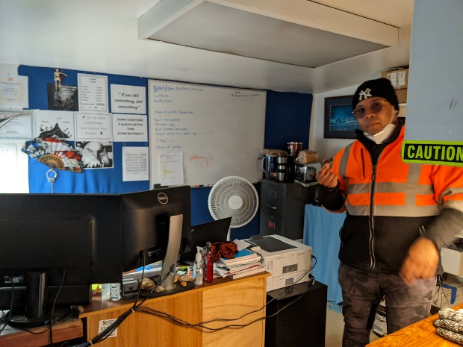
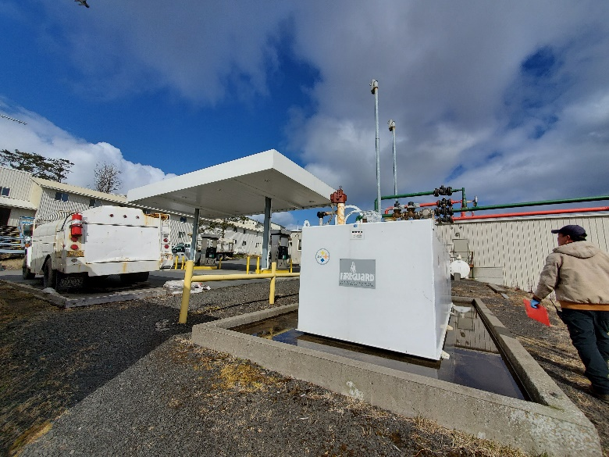
Supporting Onsite Folks

Slide 7
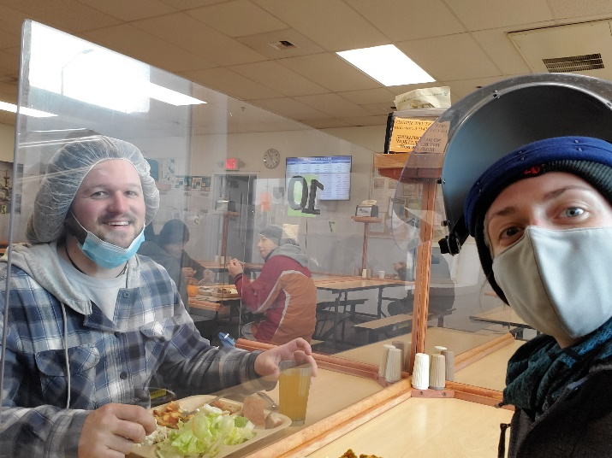
Build relationship and trust
Check In
Make clear you’re on the same team
Ask them how you can help make their days easier!
Notes:
Most people want to do a good job
Folks that are remote,
FOLKS ARE DOING MULTPLE JOBS

Slide 8
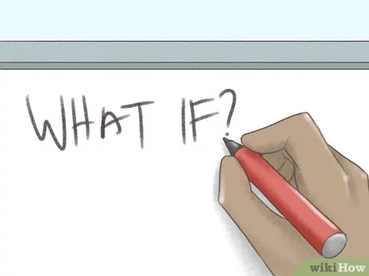
Initial Planning
Plan A
Plan B
Plan C
Plan D
Plan E
Plan F
Just kidding
Notes:
Budgeting
Timelines
Large equipment, ship early
Communicating Expections

Slide 9
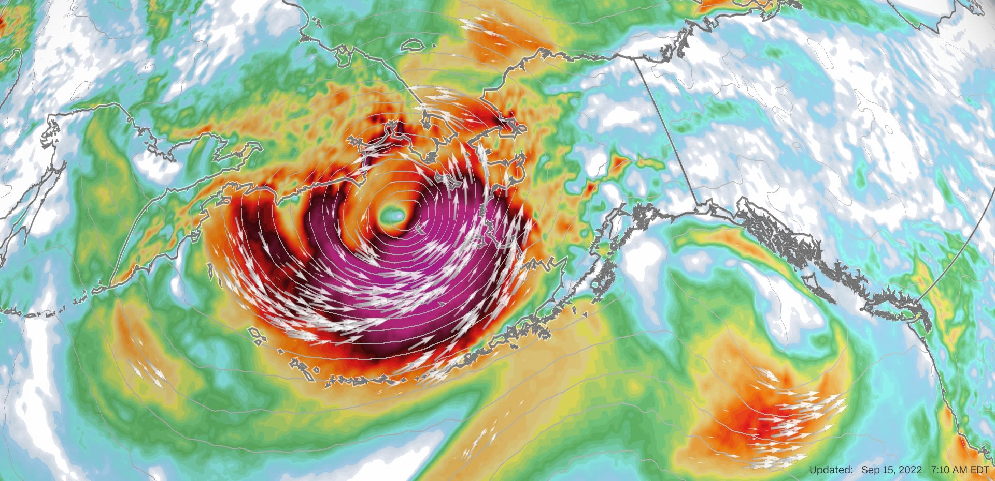
Factors out of control
Weather
Flights Schedules
Helpful to have contacts with smaller local aircraft
Barge Schedules
Network/Internet outages
Notes:
Community Members to help if you have a strong relationship with them
Story about getting off an island

Slide 10
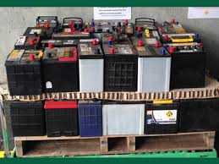
Equipment
Be aware of hazmat requirements
Storage (time and amount)
Batteries
Alkaline vs Lead Acid
Generator
Diesels
Transportation Requirements
Hazardous Waste Manifests
Notes:
Coast Guard

Slide 11
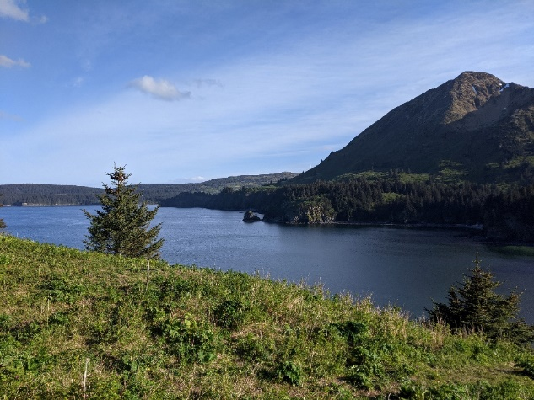
Good Training Documents
English the first language?
Average reading level in US is 7th to 8th grade¹
Use ChatGPT
Translate
Assessable?
High contrast, readable fonts, flow charts/checklists, photos (if printed in black and white, can you still tell what it is)

Slide 12
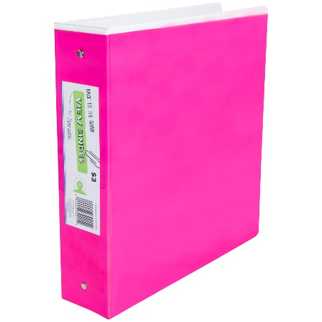
Good Training Documents, Continued
Finding information can be really tough. Making it
Easy to find
Easy to read
Add Photos
Compress when possible
Easy to explain the ‘WHY’
Think about the next step
Laminate WW resources so they can take the out of the office without them getting ruined
Print and mail a fun binder (limited printer access)

Slide 13
Good Training Documents, Continued
Never ‘final’ document
Ask for their comment and input
Fine line between adding more work and partnering
Small document size
Common issues and what to do, challenge yourself to learn more about onsite work, GO DO IT

Slide 14
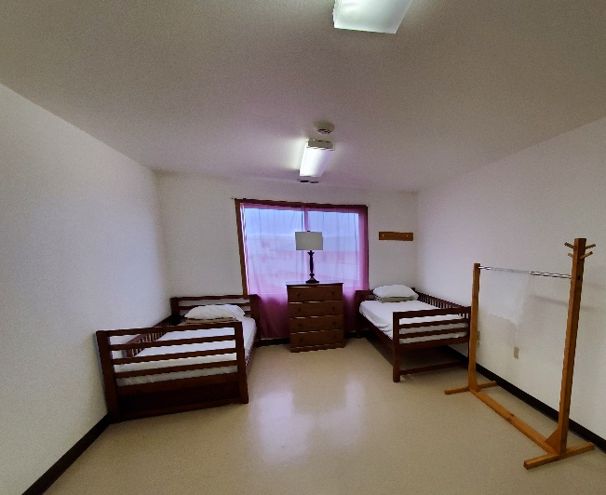
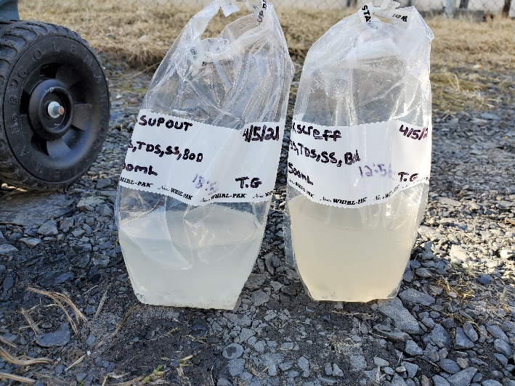
Miscellaneous
Break down tasks, smaller
Samples
Storage temperature, location, amount of time before analyzed
Housing
Female housing?

Slide 15
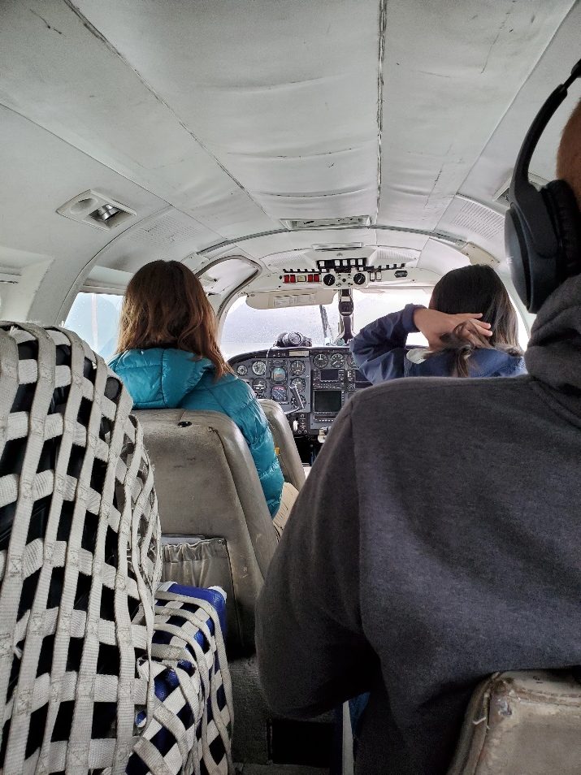
Example: External Tank Inspection
Flying out contractor
Flying, to another plane, to a helicopter/boat (weather depending), to a transport van (is it safe)
All possible flights in and out
Backup plans - Trains? Boats? Barges? Postal Service?
Needs equipment sent
Ahead of time on barge? Mail? Internal transport?
What equipment do they need? If it can’t be fly, barge? Train? How early? DOT/HAZMAT compliant?
Getting equipment back
Notes:
Modeling Air Emission trigger
Does contractor know what to expect
Flight to A to B
Briefing of task (first time going remote or is it a local company)
Deadline for inspection? How tight is timeline

Slide 16
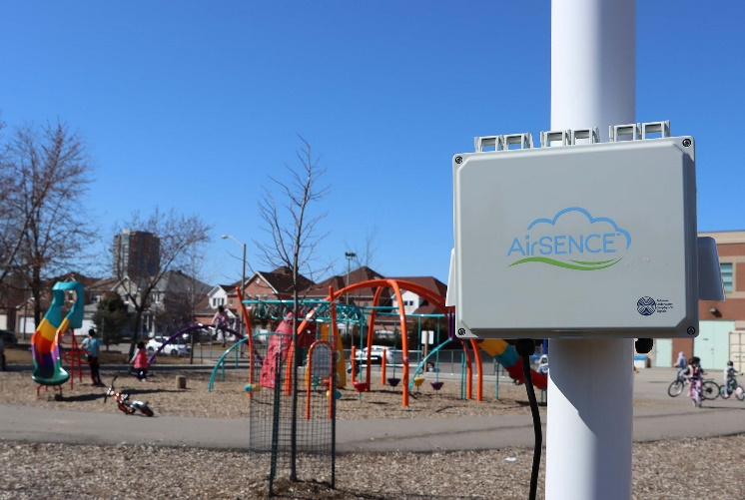
Air Monitoring in Remote Location
Solar Panels
Backup Power
Batteries/Power
Accumulation
Cellular Data Coverage
Data transmitted to a dashboard with routine review is critical

Slide 17
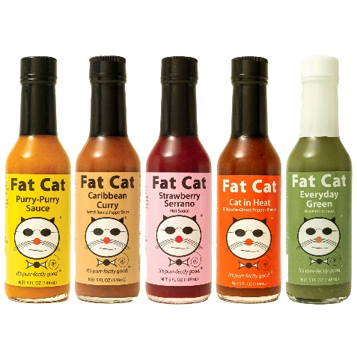
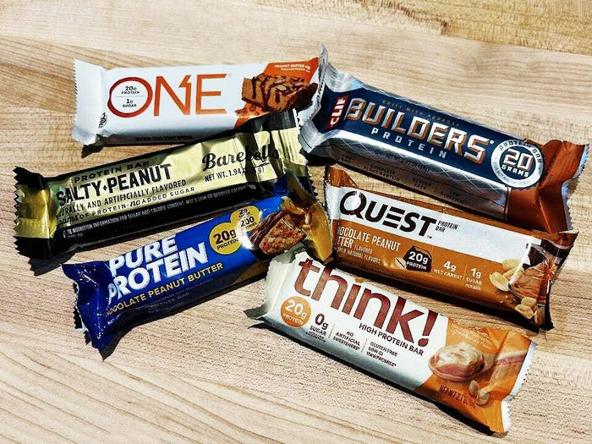
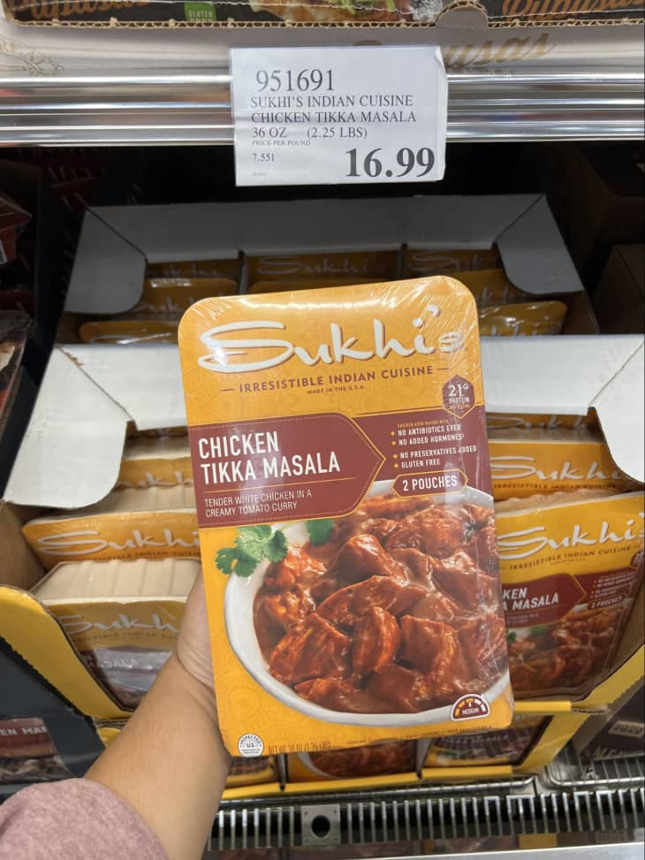
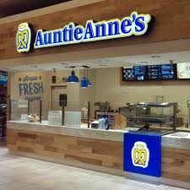
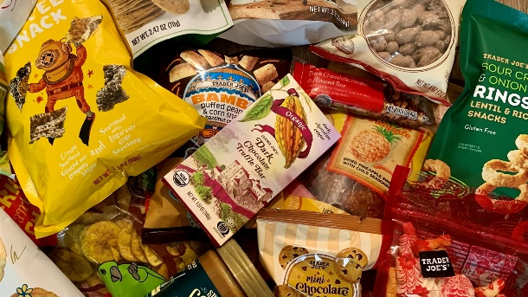
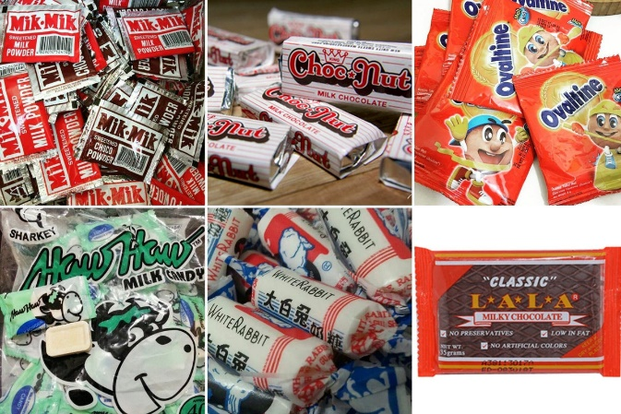
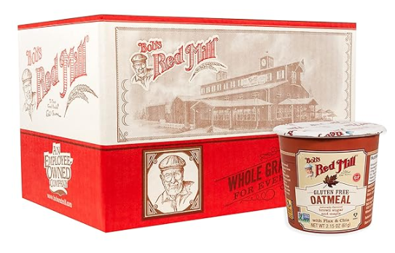
Pack SNACKS
Value added snacks
Add to rice, make cafeteria food better
Ask what they want
Find regional specialties
Mailing + snacks

Slide 18
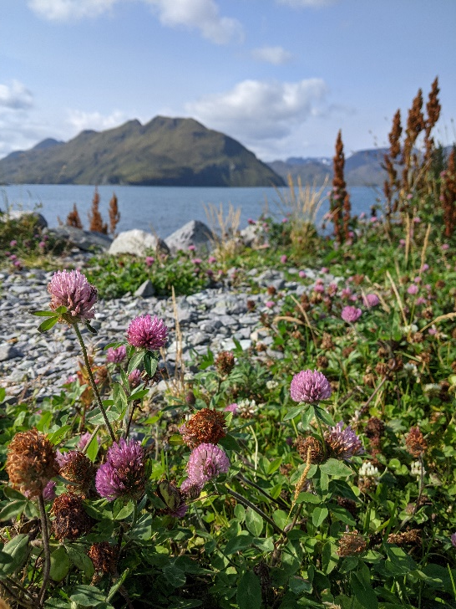
In Conclusion
Flex your patience
Plan and Research ahead of time
Develop Relationships
Create great resources
Bring snacks

Slide 19
Thank you
Questions?

